Slide 1
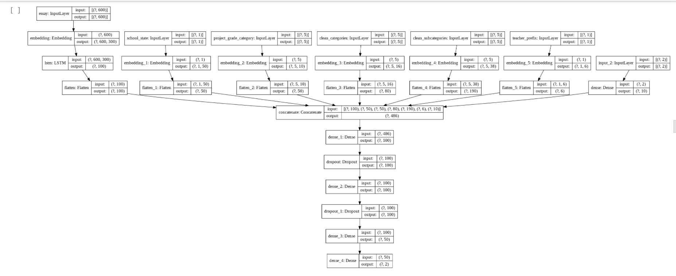
LSDM ON DONAR CHOOSE

Slide 2
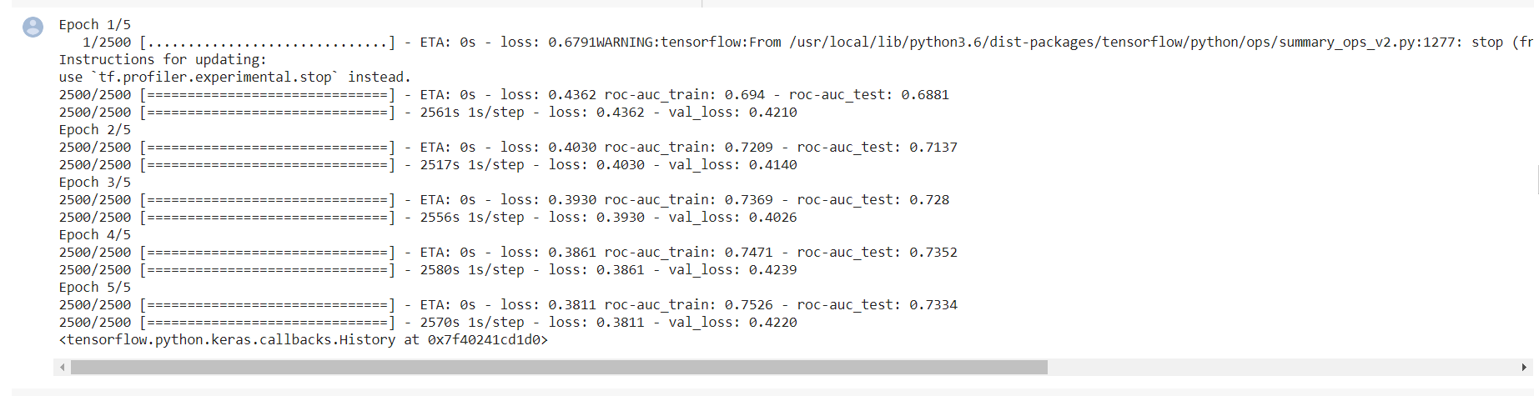
ETA ,AUC TRAIN AND AUC TEST FOR MODEL 1

Slide 3
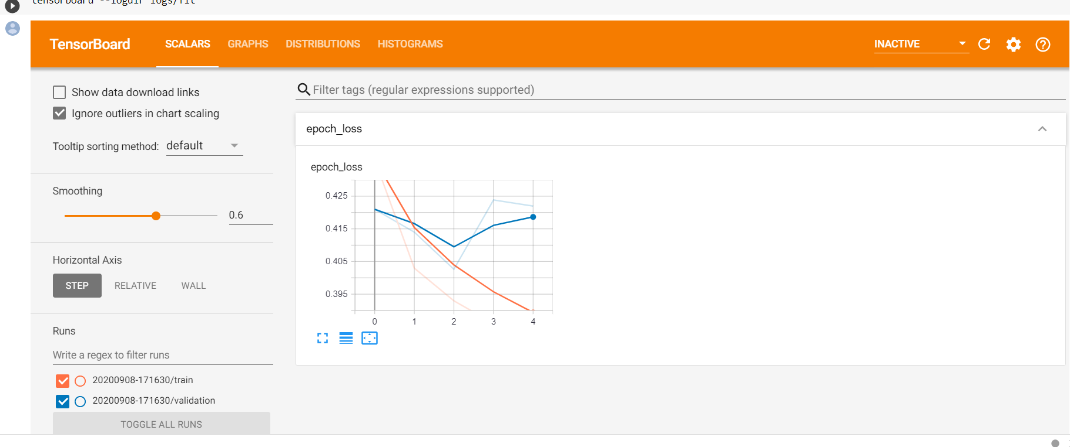
ETA loss decreasing from 0.4362 in 1st epoch to 0.3811 in 5th epoch AUC train increasing from 0.694 in 1st epoch to 0.765 at 5th Epoch AUC test increasing from 0.6881 in 1st epoch to 0.7334 at 5th epoch

Slide 4
OBSERVATION FOR MODEL -1
Observations
1. After every epoch loss is decreasing and AUC score is increasing
2. From epoch 4 to 5 roc_auc_train is increased but roc_auc_test slightly decreased.
3. Highest AUC_train is - 0.7526 and AUC_test is -0.7334

Slide 5
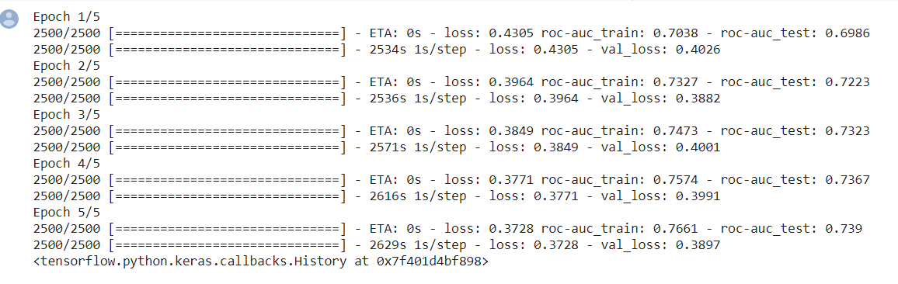
MODEL 2 ETA ,AUC TRAIN AND AUC TEST FOR MODEL 2
ETA loss decreasing from 0.4305 in 1st epoch to 0.3728in 5th epoch AUC train increasing from 0.7038 in 1st epoch to 0.7661 at 5th Epoch AUC test increasing from 0.6986 in 1st epoch to 0.739at 5th epoch

Slide 6
OBSERVATIONS FOR MODEL - 2
1. On every epoch loss is decreasing.
2. roc_auc_train and roc_auc_test is slightly better than model-1
3. highest auc_train = 0.7661 and auc_test = 0 .739

Slide 7
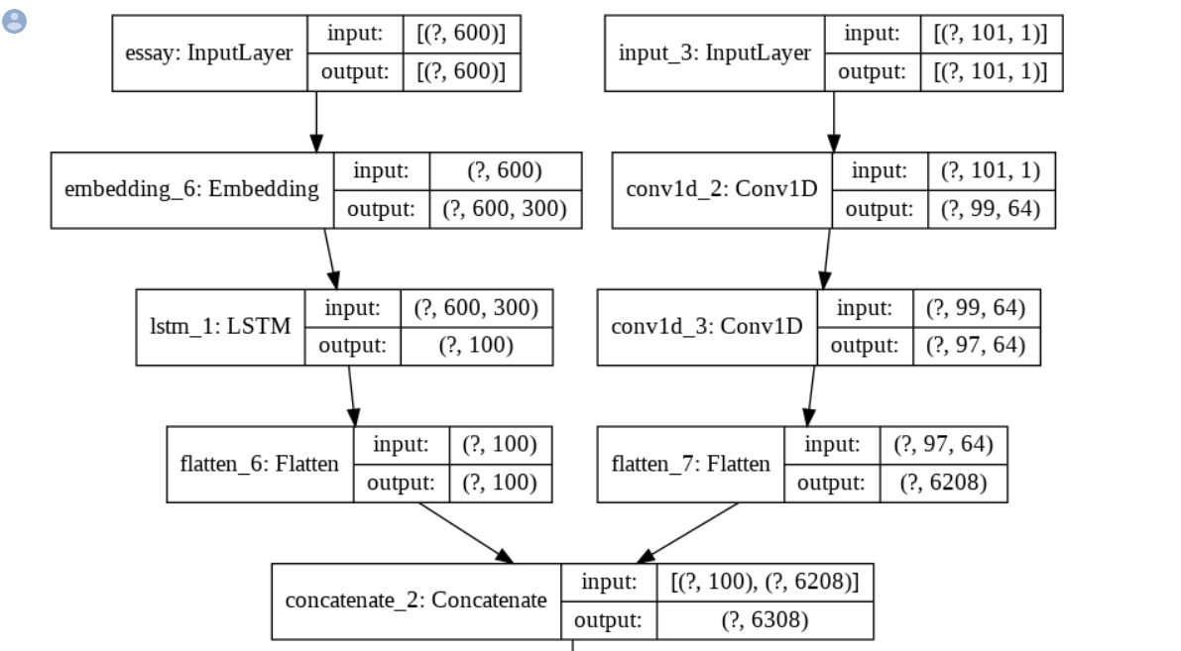
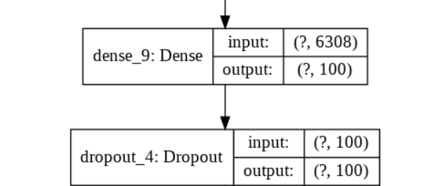
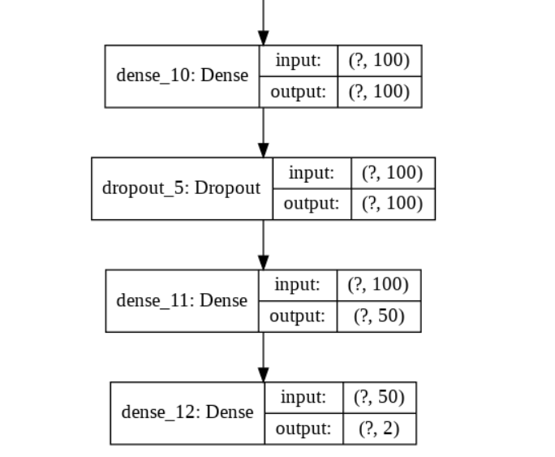
Model-3
multi_input_and_output_model.png

Slide 8
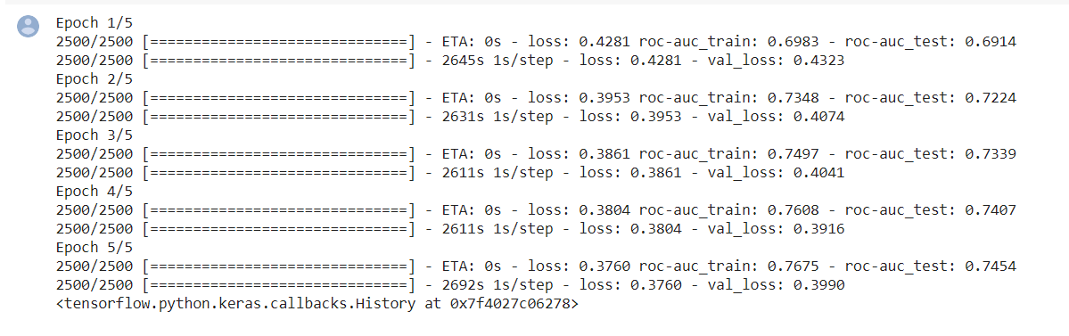
ETA ,AUC TRAIN AND AUC TEST FOR MODEL 3
ETA loss decreasing from 0.4281 in 1st epoch to 0.3760in 5th epoch AUC train increasing from 0.6983 in 1st epoch to 0.7675 at 5th Epoch AUC test increasing from 0.6914 in 1st epoch to 0.7454 at 5th epoch

Slide 9
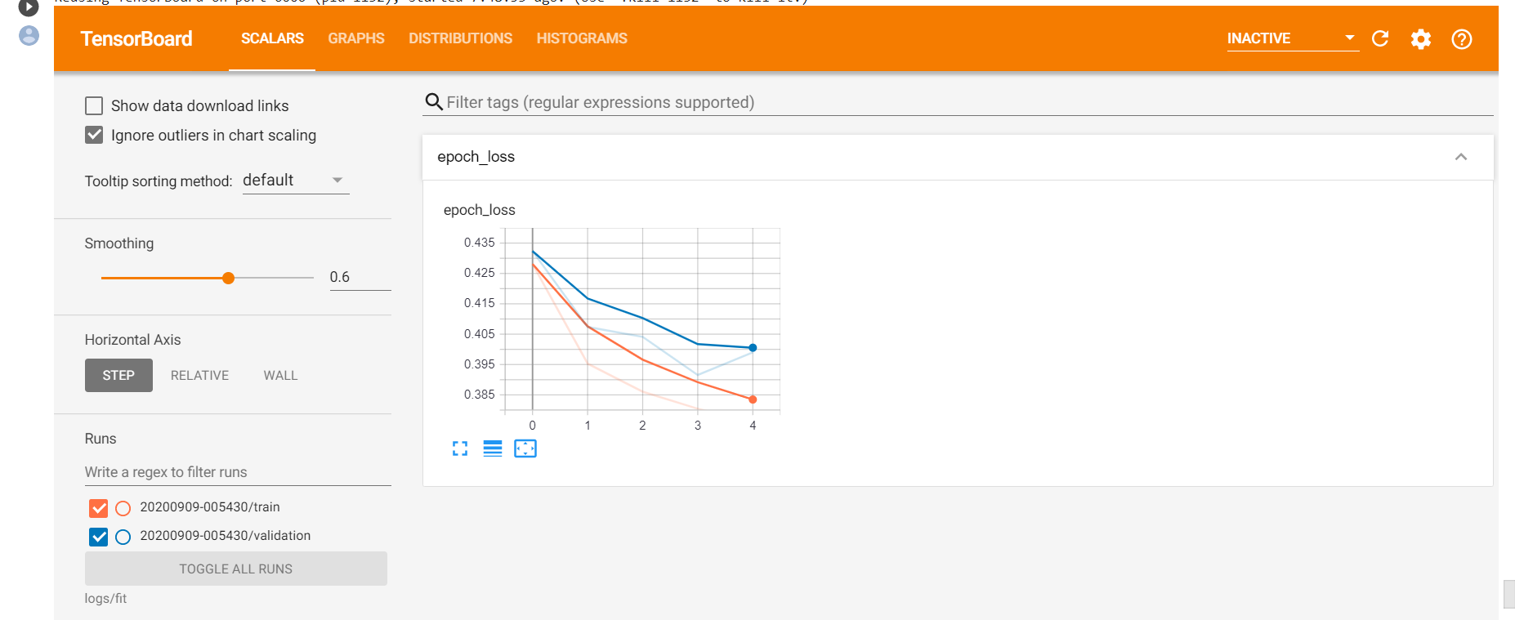

Slide 10
Observations
OBSERVATIONS FOR MODEL 3
After every epoch loss is decreasing and AUC score is increasing
roc_auc_train and roc_auc_test is slightly better than model-1 and model-2
Test_auc score highest value is 74.54% .

